Slide 1
Learning ASP.NET Core Web API

Slide 2
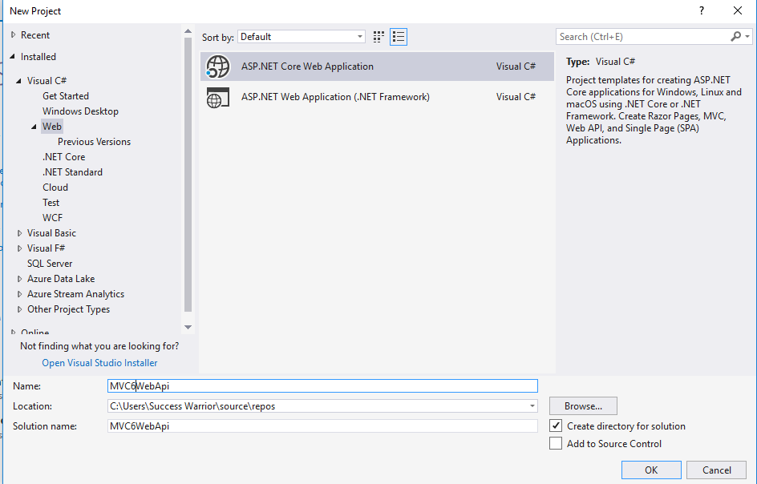

Slide 3
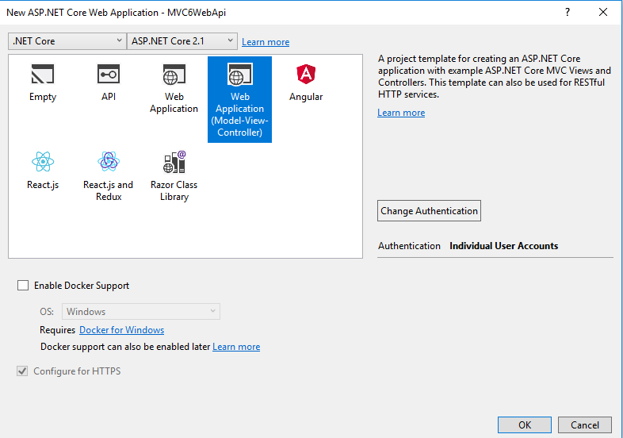

Slide 4
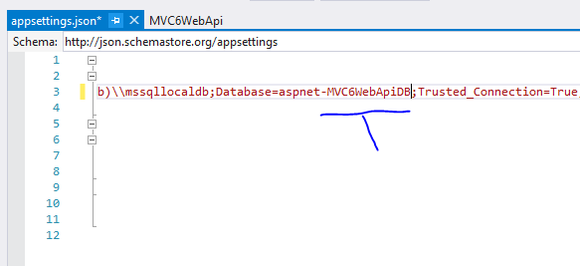

Slide 5
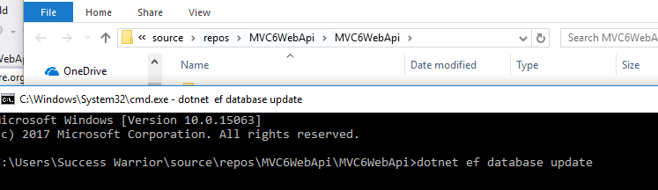

Slide 6
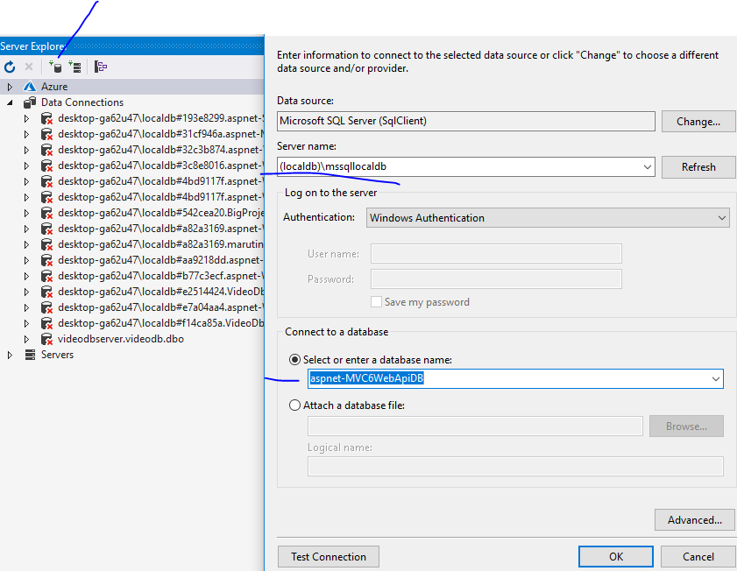

Slide 7
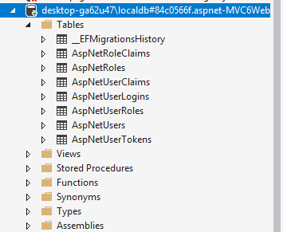

Slide 8
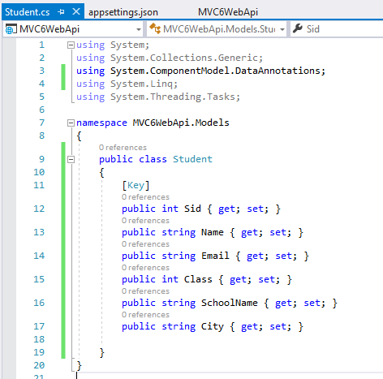

Slide 9
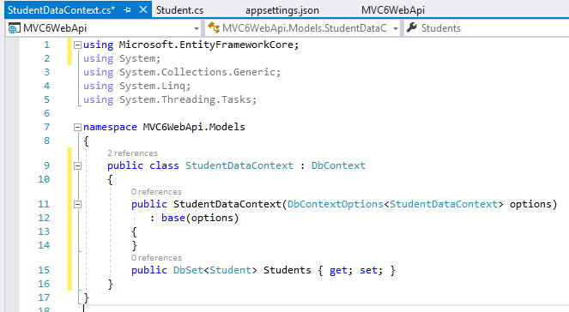

Slide 10
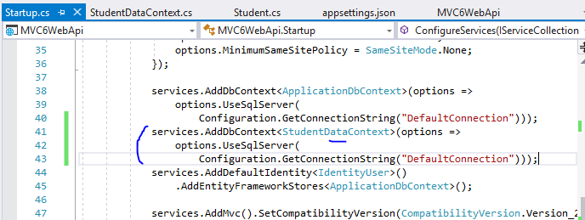

Slide 11
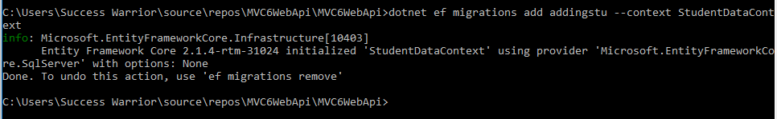
dotnet ef migrations add addingstu - -context StudentDataContext

Slide 12
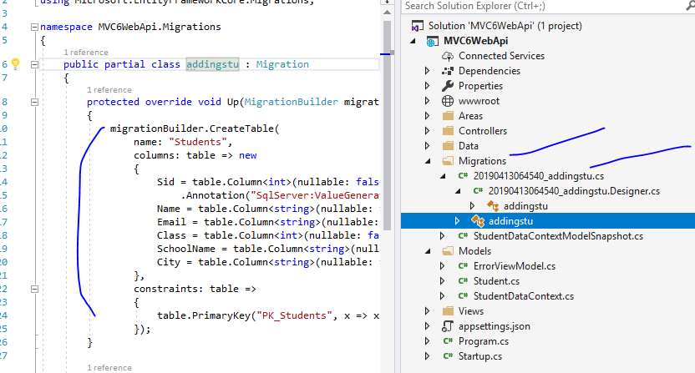

Slide 13
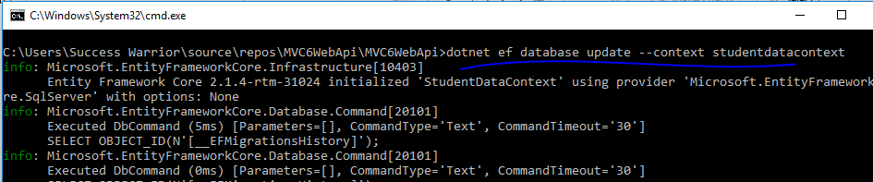
dotnet ef databse update - -context StudentDataContext

Slide 14
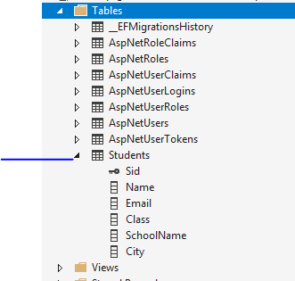

Slide 15
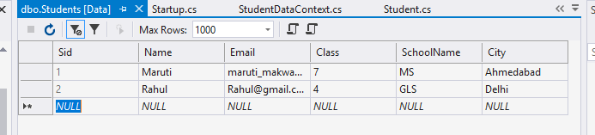

Slide 16
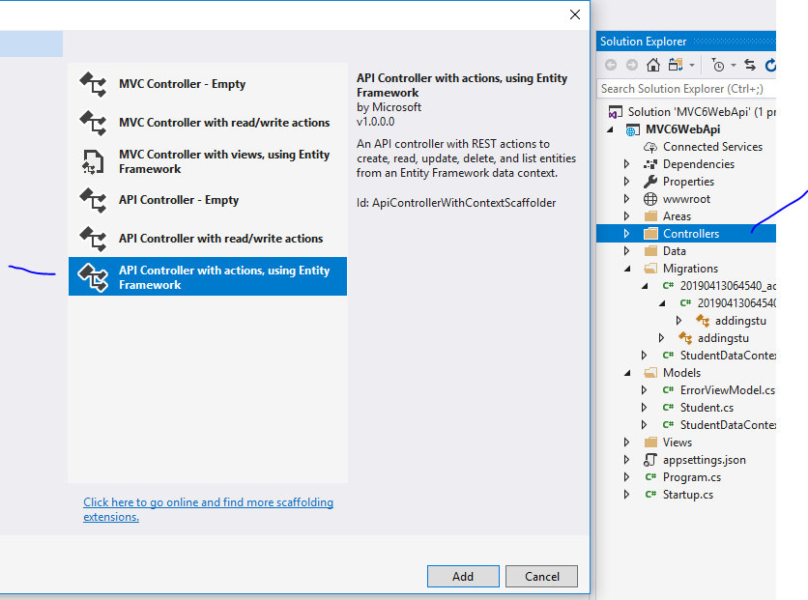

Slide 17
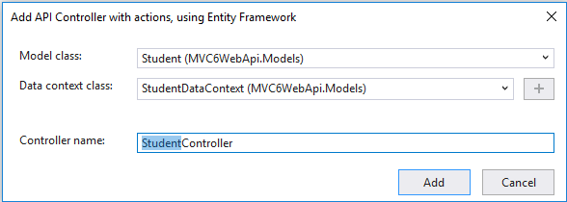

Slide 18
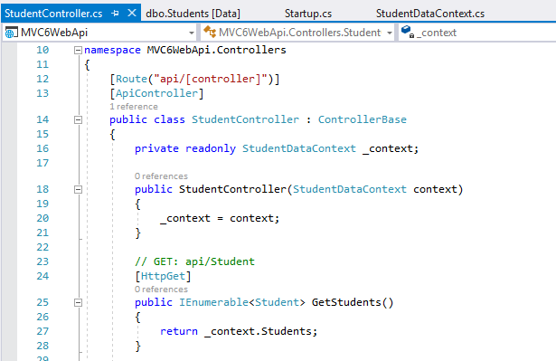

Slide 19
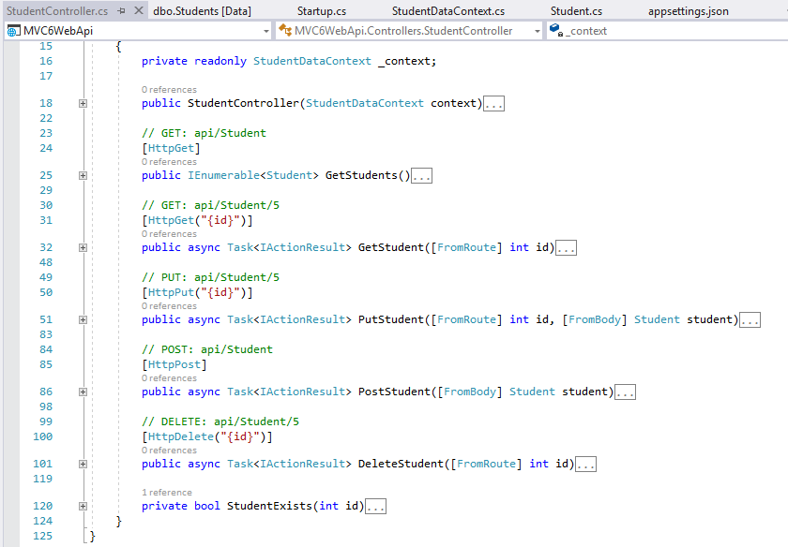

Slide 20
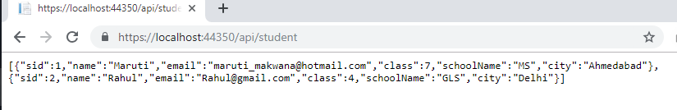
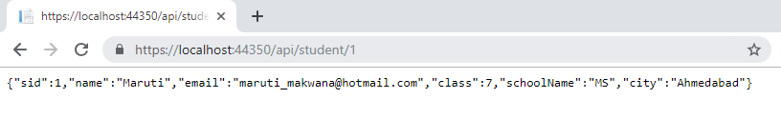

Slide 21
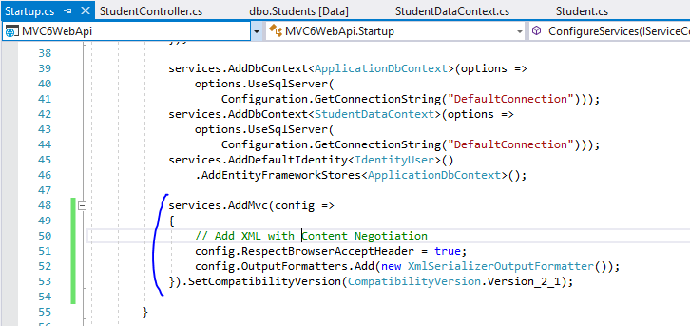

Slide 22
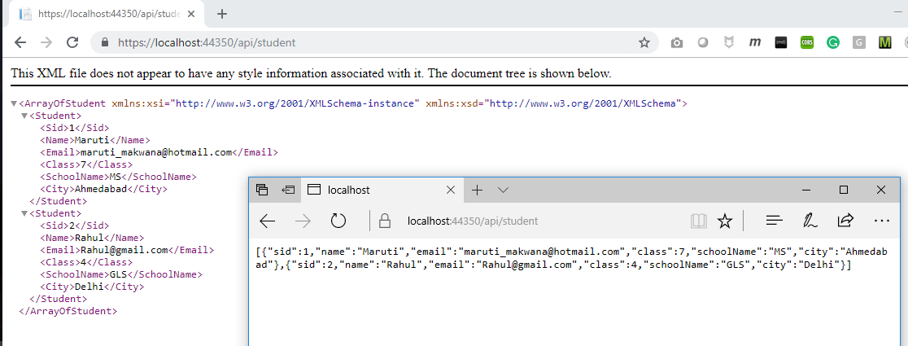

Slide 23
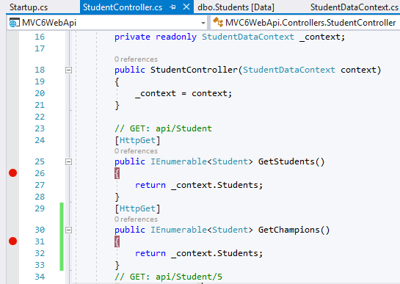

Slide 24
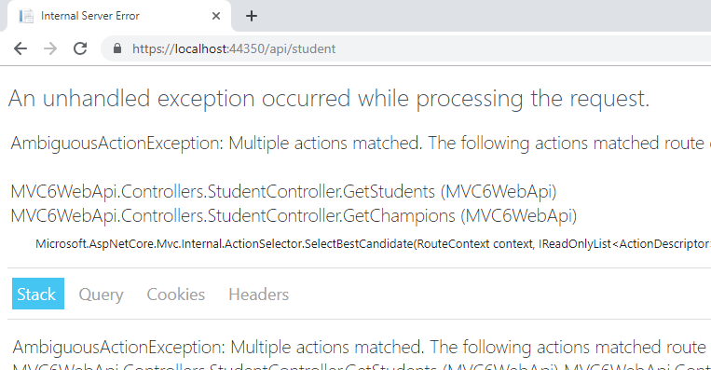

Slide 25
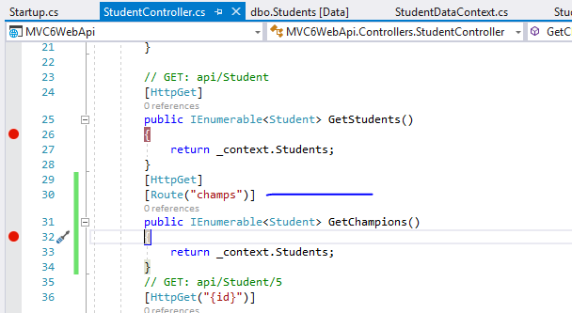

Slide 26
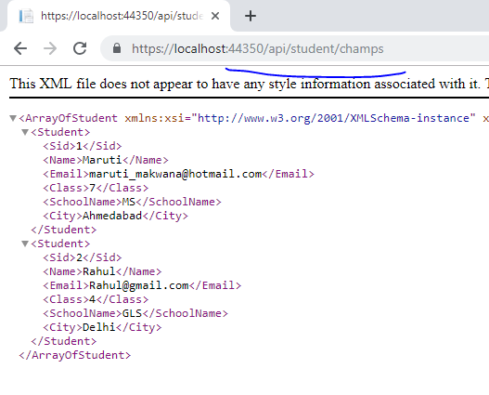

Slide 27
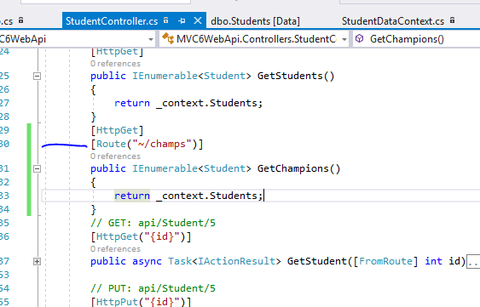

Slide 28
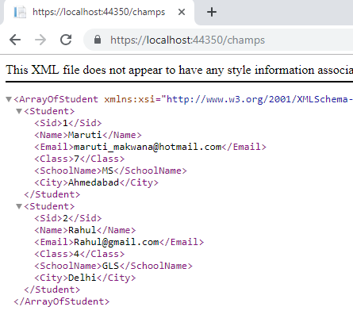

Slide 29
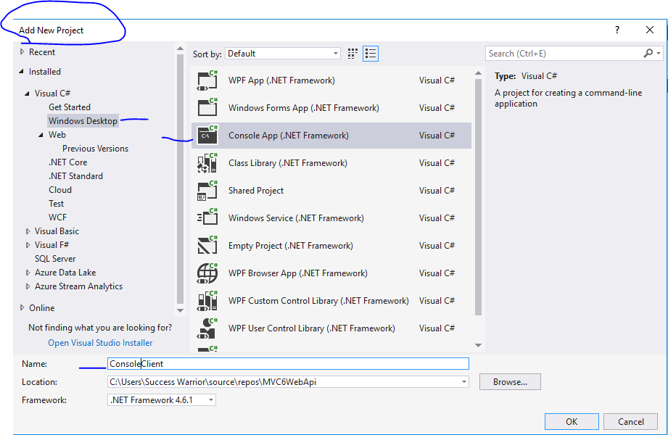
Inside Same solution

Slide 30
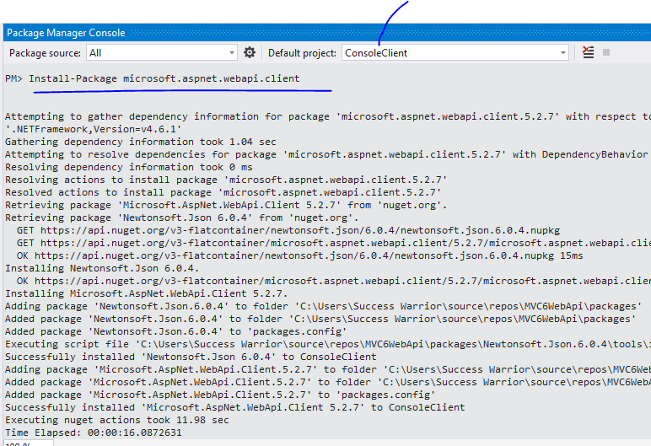

Slide 31
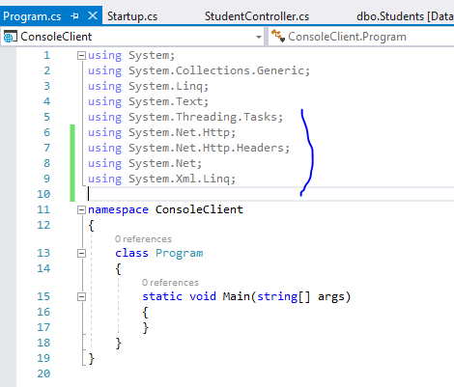

Slide 32
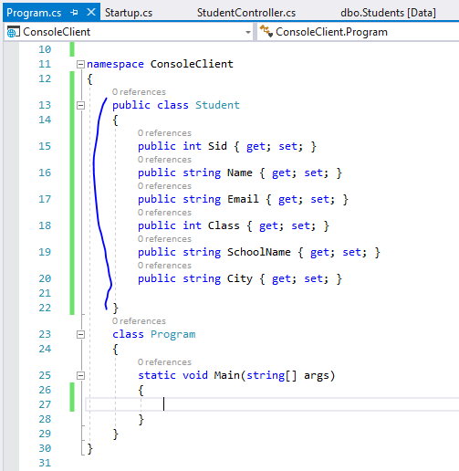

Slide 33
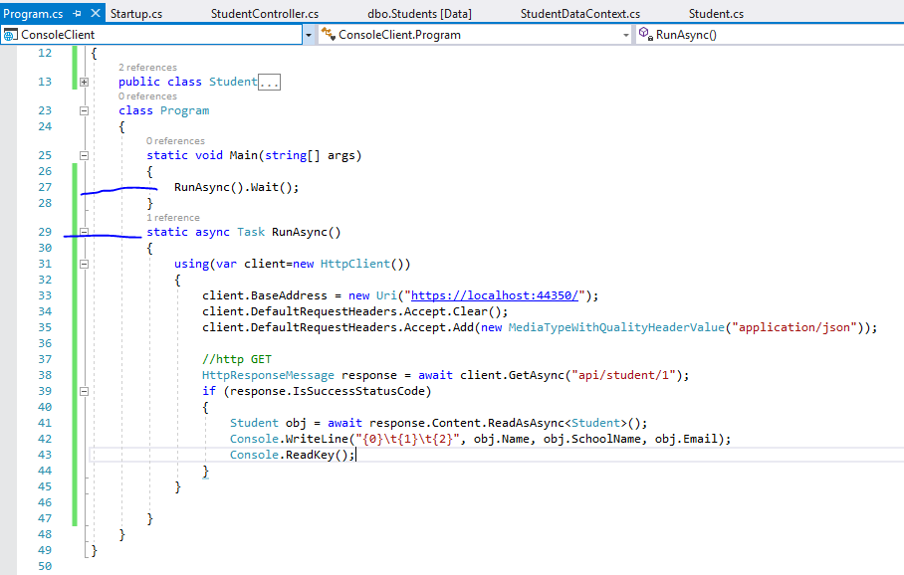

Slide 34
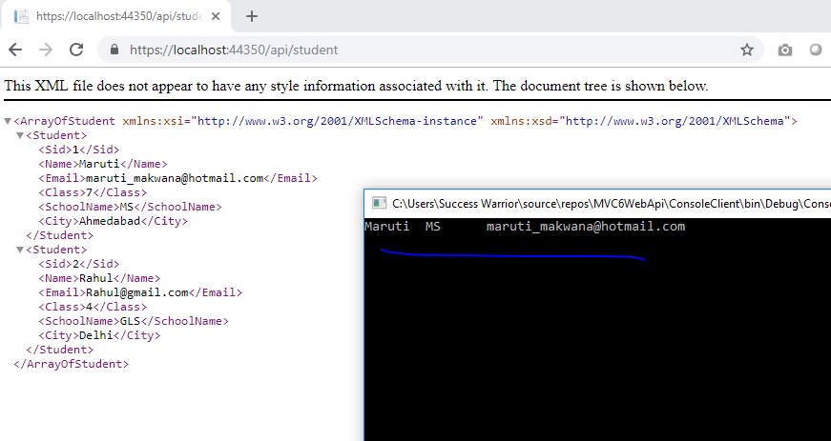

Slide 35
IF you want to handle validations in better way then
1- use action filters
2- use fluent validation

Slide 36
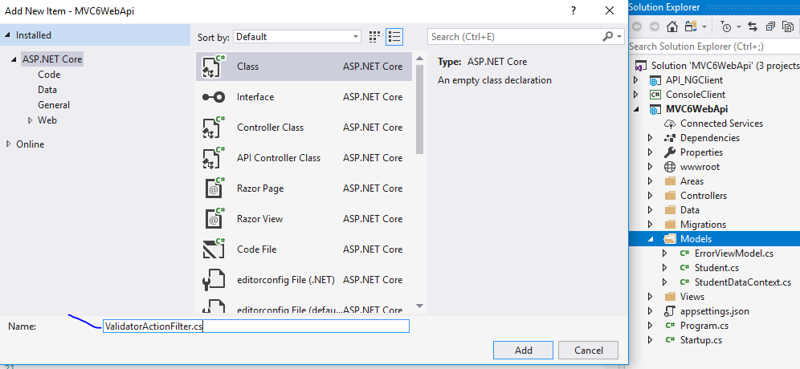

Slide 37
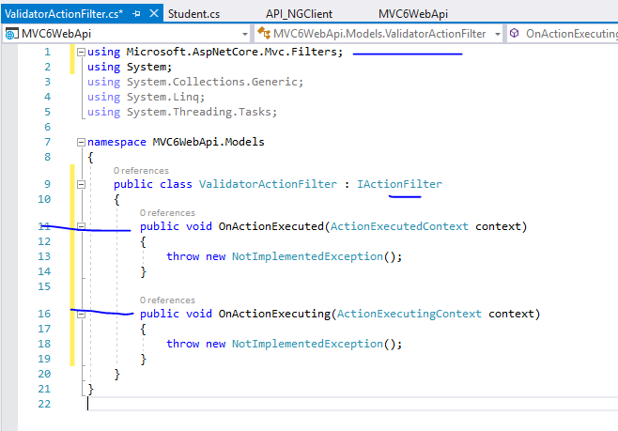

Slide 38
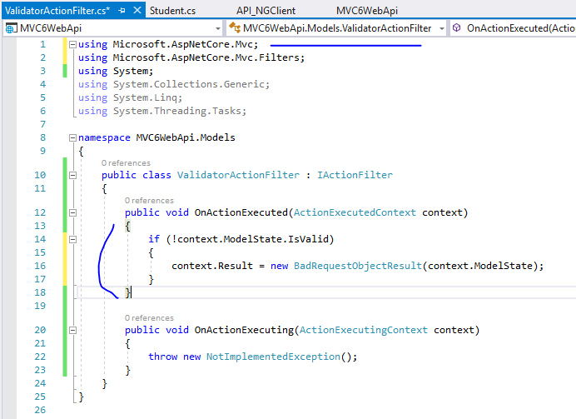
We can write anything to handle this in our own way

Slide 39
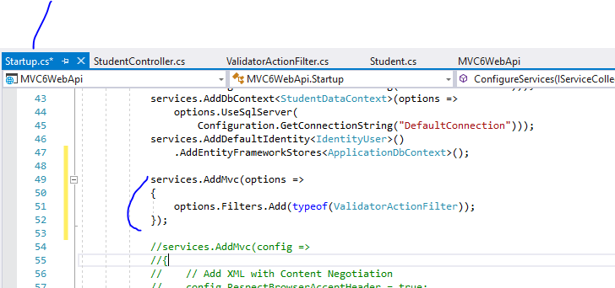
Registering it globally

Slide 40
Fluent Validation allows you to separate validation rules from your model and helps you structure the rules so that they are nice and readable. The rules are also super easy to test.

Slide 41
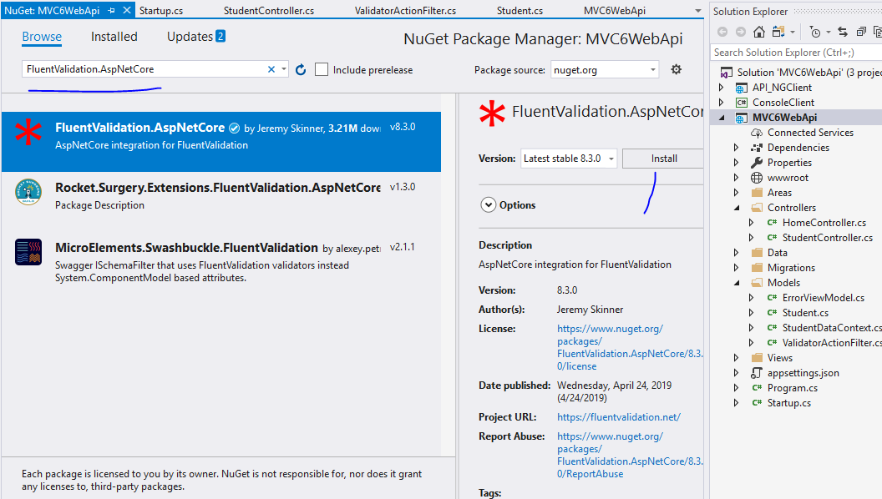

Slide 42
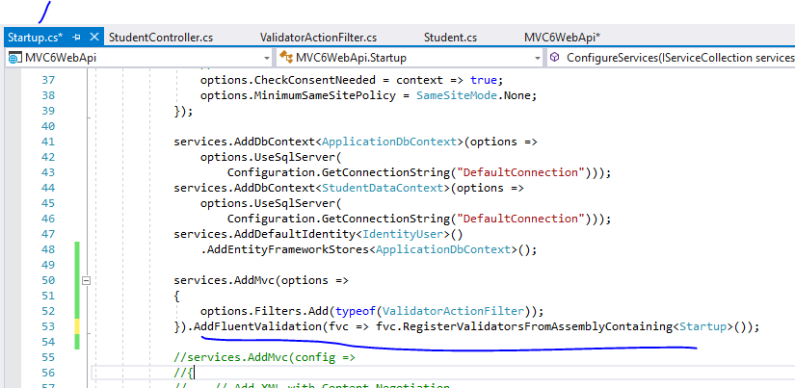

Slide 43
Now let’s add a validation to ensure Student Name is populated on the model using the power of Fluent Validation

Slide 44
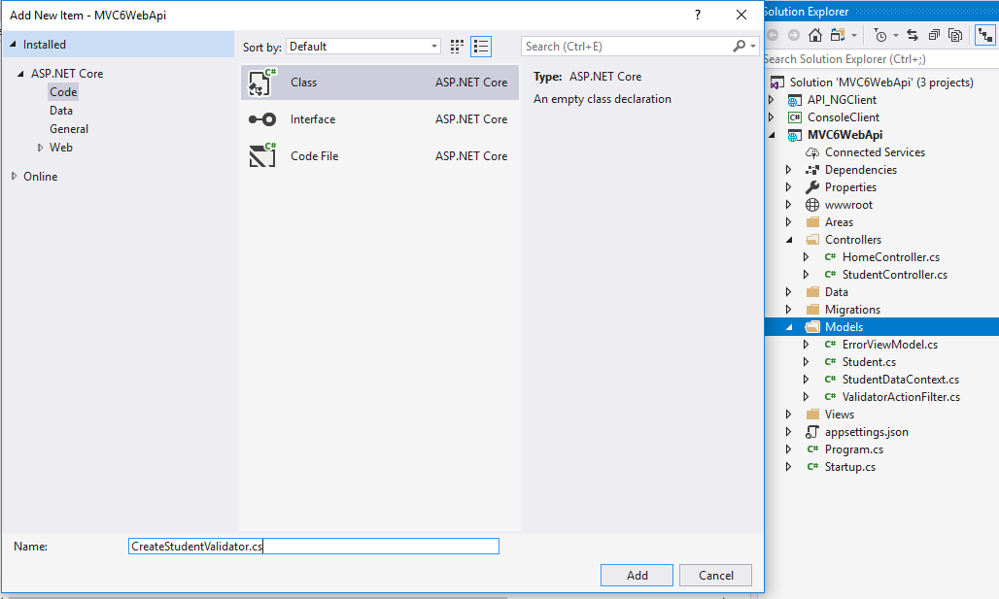

Slide 45
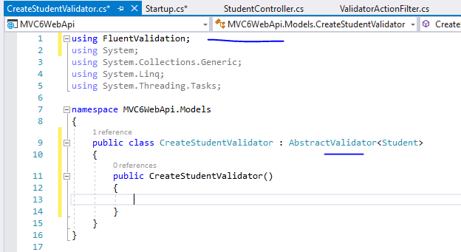

Slide 46
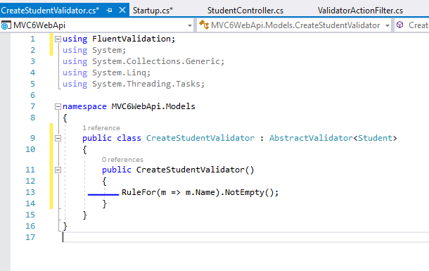
Now Name is required field

Slide 47
Comment CORS from startup

Slide 48
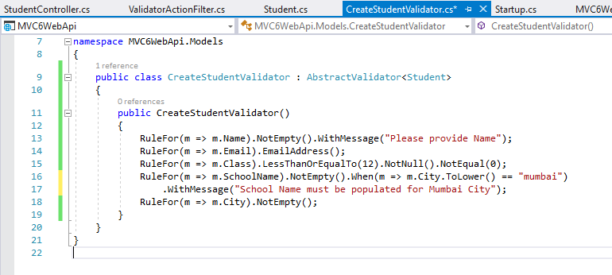

Slide 49
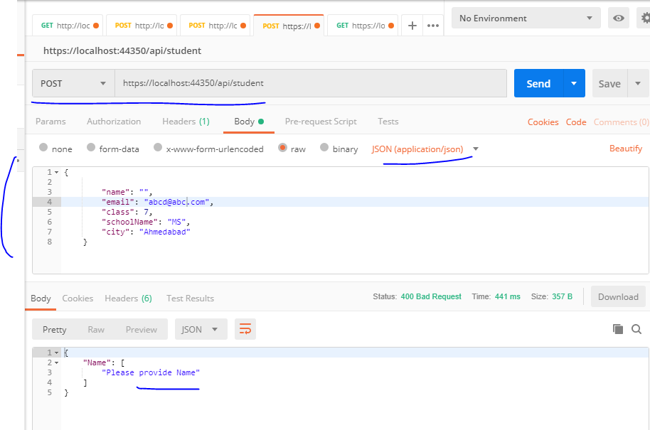

Slide 50
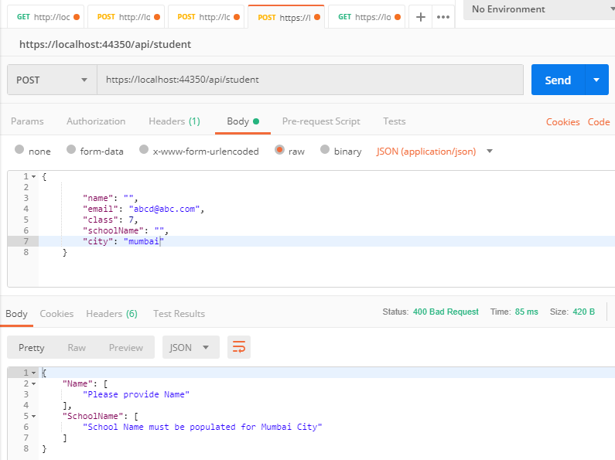

Slide 51
Swagger and Swashbuckle
What is Swagger / OpenAPI?
Swagger is a language-agnostic specification for describing REST APIs. The Swagger project was donated to the OpenAPI Initiative, where it's now referred to as OpenAPI. Both names are used interchangeably; however, OpenAPI is preferred. It allows both computers and humans to understand the capabilities of a service without any direct access to the implementation (source code, network access, documentation). One goal is to minimize the amount of work needed to connect disassociated services. Another goal is to reduce the amount of time needed to accurately document a service.
Swashbuckle is a program (JavaScript?) that generates the documentation (based on Swagger rules). Swagger UI displays the documentation. It uses Swashbuckleto do this

Slide 52
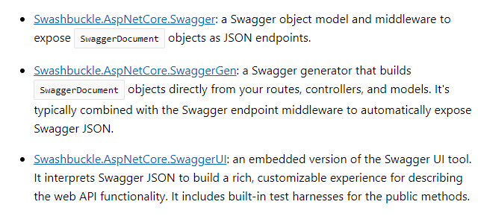
There are three main components to Swashbuckle:

Slide 53
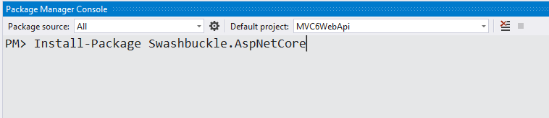

Slide 54
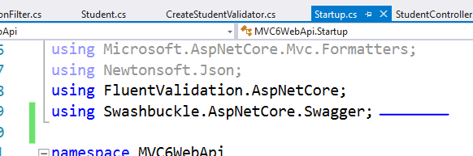
Add and configure Swagger middleware

Slide 55
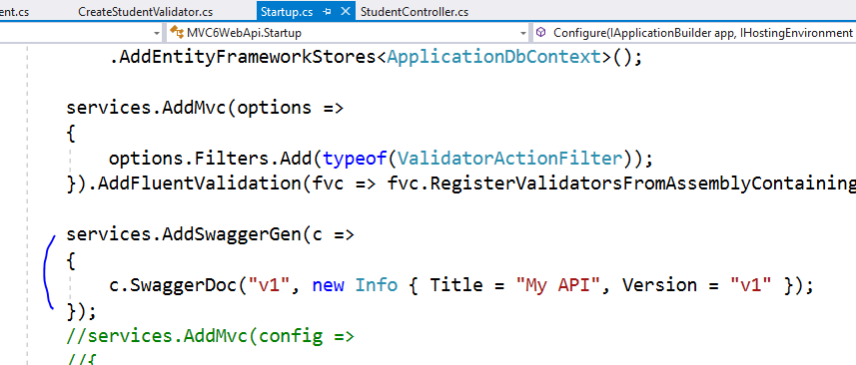

Slide 56


Slide 57


Slide 58


Slide 59


Slide 60
API info and description
The configuration action passed to the AddSwaggerGen method adds information such as the author, license, and description:

Slide 61


Slide 62


Slide 63


Slide 64


Slide 65


Slide 66
Response caching
Response caching reduces the number of requests a client or proxy makes to a web server. Response caching also reduces the amount of work the web server performs to generate a response. Response caching is controlled by headers that specify how you want client, proxy, and middleware to cache responses.
The other useful type of caching is in memory caching
Let’s see both so that we can understand and compare

Slide 67


Slide 68


Slide 69


Slide 70

Add new API Controller

Slide 71


Slide 72


Slide 73

Here we use the method GetOrCreate that creates an entry in the server memory the first time we use it with a specific entry “MyCacheKey”, The operation result that needs to be cached is executed this time.
The second time the operation is called, method will check in the memory if an entry with the “MyCacheKey” exists, and will load it from memory. The operation that provides the result is not executed.
For the cache expiracy we have AbsoluteExpirationRelativeToNow option because the cache will expire after a precise time. By this way you will ensure your data will be up to date after a certain moment.

Slide 74

This case represents a cache stored on the server or / and on the client browser.
Duration that indicates the time of expiracy in seconds
Location allow to choose where to cache your response (Any for client + browser, Client for the browser only, None to avoid any caching)
In the code sample above, I cache my action for 1 minute on the client and the server.

Slide 75


Slide 76



Slide 77


Slide 78



Slide 79
Now I want to Introduce Repository in this Sample

Slide 80



Slide 81


Slide 82


Slide 83


Slide 84



Slide 85


Slide 86


Slide 87


Slide 88



Slide 89
Now let’s handle Exception

Slide 90

Add new folder and 3 new classes

Slide 91
There are 2 cases :
First case: it’s a custom error that we know what to do with and what to send to the client BaseCustomException
Second case: it’s an unmanaged error that we don’t know what to do with, we will send a generic error message to the client.

Slide 92


Slide 93


Slide 94


Slide 95


Slide 96


Slide 97


Slide 98


Slide 99


Create simple controller like this

Slide 100


Slide 101




Slide 102
Logging
Often overlooked, logging errors and other information in case of bug in the program is an essential feature in a Web API.
In this article we will see how to implement logging in a rolling file in an ASP.NET Core WebAPI with Serilog.
Serilog, Like many other libraries for .NET, Serilog provides diagnostic logging to files, the console, and elsewhere.

Slide 103

Download these three packages:

Slide 104


Configuring appsettings.json
There are three big parts in the configuration
Logging minimum level: In this example the minimum log level is “Information”
Serilog itself: “WriteTo”, as you can see it’s an array, it means you can setup many Sinks (destination of the log), in our case “RollingFile”
Properties: “Application” allows you to name your log if you want to know what log belongs to what application.

Slide 105

Configuring Startup.cs

Slide 106

Then we need to add Serilog to the LoggerFactory in the Configure method:
serilog override the default Microsoft Logger provided by the assembly: Microsoft.Extensions.Logging

Slide 107


Slide 108


Let’s create an action that catch an exception and logs it:

Slide 109



Slide 110
Authentication and authorization are required to restrict access to custom and / or sensitive data. A safer technique than cookie protection is to use tokens, provided by a tier provider. In this we will talk about JWT with OpenID Connect.
OpenID Connect 1.0 is a simple identity layer on top of the OAuth 2.0 protocol. It allows Clients to verify the identity of the End-User based on the authentication performed by an Authorization Server, as well as to obtain basic profile information about the End-User in an interoperable and REST-like manner. OpenID Connect allows clients of all types, including Web-based, mobile, and JavaScript clients, to request and receive information about authenticated sessions and end-users.

Slide 111

Download Microsoft.AspNetCore.Authentication.JwtBearer Nuget package

Slide 112

Set authentication scheme for JWT

Slide 113

Set JWT provider configuration
Audience represents the intended recipient of the incoming token or the resource that the token grants access to. If the value specified in this parameter doesn’t match the aud parameter in the token, the token will be rejected because it was meant to be used for accessing a different resource. Note that different security token providers have different behaviors regarding what is used as the ‘aud’ claim (some use the URI of a resource a user wants to access, others use scope names). Be sure to use an audience that makes sense given the tokens you plan to accept.
Authority is the address of the token-issuing authentication server. The JWT bearer authentication middleware will use this URI to find and retrieve the public key that can be used to validate the token’s signature. It will also confirm that the iss parameter in the token matches this URI.

Slide 114

Set autorization policies
This policy require a role claim type with value “SurveyCreator”

Slide 115

Protect your actions with Authorize Attribute
Remember that if you don’t provide a toekn to your Api or you provide a wrong or expired token the answer will be Http Unauthorized.
If your token doesn’t satisfy the policy, you will get Http Forbidden.

Slide 119
Now I want to use HATEOAS

Slide 120
HATEOAS (Hypermedia as the Engine of Application State) is a constraint of the REST application architecture that keeps the RESTful style architecture unique from most other network application architectures. The term “hypermedia” refers to any content that contains links to other forms of media such as images, movies, and text.
This architectural style lets you use hypermedia links in the response contents so that the client can dynamically navigate to the appropriate resource by traversing the hypermedia links. This is conceptually the same as a web user navigating through web pages by clicking the appropriate hyperlinks in order to achieve a final goal.

Slide 121


Slide 122


Slide 124


Slide 127
Now I want to consume this in angular
Application in JSON format only
ANGULAR 6 Onwards

Slide 128


Slide 129

Much clean
Json data
With caml case

Slide 130


Slide 131


Slide 132


Slide 133


Slide 134


Slide 135


Slide 136


Slide 137


Slide 138


Slide 139


Slide 140

We need to enable CORS

Slide 141

Add this code
In webapi
project

Slide 142


Slide 143


Slide 144


Slide 145

Still working

